Slide 1

NML Progress
OGF 29, Chicago

Slide 2
OGF IPR Policies Apply
“I acknowledge that participation in this meeting is subject to the OGF Intellectual Property Policy.”
Intellectual Property Notices Note Well: All statements related to the activities of the OGF and addressed to the OGF are subject to all provisions of Appendix B of GFD-C.1, which grants to the OGF and its participants certain licenses and rights in such statements. Such statements include verbal statements in OGF meetings […]
Excerpt from Appendix B of GFD-C.1: ”Where the OGF knows of rights, or claimed rights, the OGF secretariat shall attempt to obtain from the claimant of such rights, a written assurance that upon approval by the GFSG of the relevant OGF document(s), any party will be able to obtain the right to implement, use and distribute the technology or works when implementing, using or distributing technology based upon the specific specification(s) under openly specified, reasonable, non-discriminatory terms. The working group or research group proposing the use of the technology with respect to which the proprietary rights are claimed may assist the OGF secretariat in this effort. The results of this procedure shall not affect advancement of document, except that the GFSG may defer approval where a delay may facilitate the obtaining of such assurances. The results will, however, be recorded by the OGF Secretariat, and made available. The GFSG may also direct that a summary of the results be included in any GFD published containing the specification.”
Notes:
IPR Notices Note Well for OGF meetings

Slide 3
OGF IPR Policies Apply
Some works (e.g., works of the U.S. government) are not subject to copyright. However, to the extent that the submission is or may be subject to copyright, the contributor, the organization he or she represents (if any), and the owners of any proprietary rights in the contribution grant an unlimited perpetual, non-exclusive, royalty-free, worldwide right and license to the Open Grid Forum under any copyrights in the contribution. This license includes the right to copy, publish, and distribute the contribution in any way and to prepare derivative works that are based on or incorporate all or part of the contribution, the license to such derivative works to be of the same scope as the license of the original contribution.
The contributor acknowledges that the Open Grid Forum has no duty to publish or otherwise use or disseminate any contribution.
The contributor grants permission to reference the name(s) and address(es) of the contributor(s) and of the organization(s) he or she represents (if any).
The contributor represents that contribution properly acknowledges major contributors.
The contributor, the organization (if any) he or she represents, and the owners of any proprietary rights in the contribution agree that no information in the contribution is confidential and that the Open Grid Forum and its affiliated organizations may freely disclose any information in the contribution.
The contributor represents that he or she has disclosed the existence of any proprietary or intellectual property rights in the contribution that are reasonably and personally known to the contributor. The contributor does not represent that he or she personally knows of all potentially pertinent proprietary and intellectual property rights owned or claimed by the organization he or she represents (if any) or by third parties.
The contributor represents that there are no limits to the contributor's ability to make the grants acknowledgments and agreements above that are reasonably and personally known to the contributor.
Notes:
IPR Notices Note Well for OGF meetings

Slide 4
Agenda
16:45
16:55
17:15
17:30
Tue.
Agenda & note taker & Overview
ITU and TMForum – Freek Dijkstra
Layer concepts revision – Freek Dijkstra
Path / Segment discussion – Martin Swany
Cross connect discussion – Jerry Sobiesky and Freek Dijkstra
Channels discussion
Use cases
Virtualization discussion
Notes:
Notes OGF27 not on list.
Decision: consensus on terminology, move forward and put them in schema

Slide 5
OGF27: Topical Volunteers
Device / Node / Port concepts
Network / Topology / Domain concept Inder, Jeroen
Adaptation / Layer concept Freek, Jeroen
Capabilities / Service concept Martin
Link / Path / Segment concepts Martin, Chin
Syntax representation, Identifiers Freek
Cross-connects and channels

Slide 6
OGF28: Topical Volunteers
Device / Node / Port concepts
Network / Topology / Domain concept
Capabilities / Service concept
Adaptation / Layer refinement Freek, Jeroen
Link / Path / Segment concepts Martin, Chin
Syntax representation, Identifiers Freek
Cross-connects and channels Jerry, Freek

Slide 7
OGF27: Service Example Volunteers
Adaptation Service Jeroen
Switching Matrix Service Jeroen
Segment Concatenation Service John
Multicast Service Petr
Label Conversion Service Freek
Data Transport Service Freek
Measurement Point Service
Virtualization Service
Lookup Service Gigi
Path Finding Service

Slide 8

Long Term Progres
Decide on terminology
Merge in schema
Decide on relations between terms
Refine based on requirements / use cases
Create syntax
Notes:
Cross connects incl. multicast, broadcast, fall-over connections)

Slide 9
Layer Terminology Revision
Jeroen van der Ham and Freek Dijkstra

Slide 10
Layer Definition
Layer: A collection of Ports with common Characteristic Information.
Layer: A type of encoding, so that a source Port and sink Port of a common layer can be associated together.
Notes:
Characteristic Information is defined in G.800

Slide 11
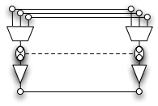
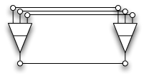
Layer Property Proposal (1)
A label is part of the layer
Con: In G.800, it is part of the adaptation. Only the termination (“layer information”) is part of the layer. The combined “layer information” (e.g. checksums) and “adaptation information” (e.g. labels) is the “characteristic information”.
Pro: No need to distinguish between adaptation and termination; no need to define trails.
A channel is just another (sub)layer
Notes:
AdaptationSource = adaptation
AdaptationSInk = de-adaptation

Slide 12
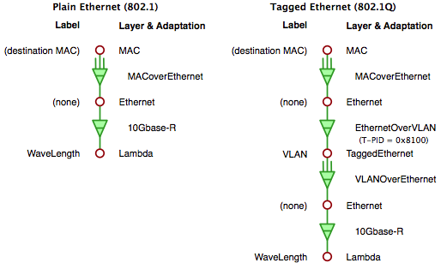
Layer Property Proposal (2)
A layer may contain at most 1 (one) label
Pro: this greatly simplifies layers and channel concept
Con: Ethernet, VLANs and I-SID are all distinct layers
Notes:
AdaptationSource = adaptation
AdaptationSInk = de-adaptation

Slide 13
Ethernet Sublayer Example (1)
Early NDL defined internal and external labels, optional labels, and source/destination labels.
Alternative: define multiple layers, each with its own label.
Notes:
AdaptationSource = adaptation
AdaptationSInk = de-adaptation

Slide 14
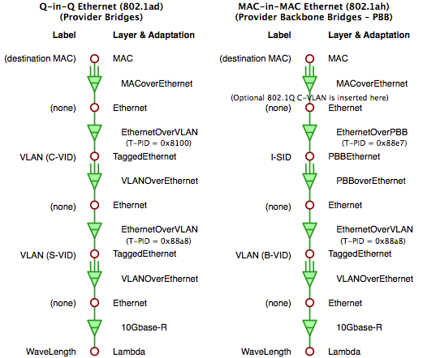
Ethernet Sublayer Example (2)
Notes:
AdaptationSource = adaptation
AdaptationSInk = de-adaptation

Slide 15
Link / Path / Segment Concepts
Martin Swany and Chin Guok

Slide 16
Cross Connect Discussion
Jerry Sobiesky and Freek Dijkstra

Slide 17
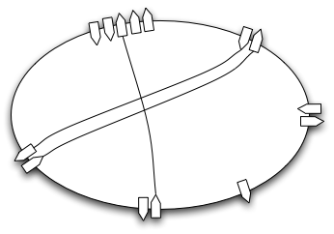
Basic Properties
Input Ports
Output Ports
Transport Function

Slide 18
Functions
Transport Function: Move data, but do not change it.
Transform Function: Change data (adaptation, label conversion), but do not move it.
Transfer Function: You tell me!? (this was used in NML/NSI discussion yesterday)

Slide 19
Questions
Are input and output ports distinct?
Do they have a different name, even for bidirectional physical ports?
Where does (de)multiplexing take place?
Is it part of the Switch Matrix, or separate?
What Functions does a Switch Matrix have?
Transport Function
Label Conversion
Adaptation

Slide 20
Channels

Slide 21
Channels
G.800:
Link port
Forwarding port
How does this map to NML “Port”?
How does this relate to NSI “STP”?

Slide 22
Multi-Layer Path Use Cases
Freek Dijkstra

Slide 23
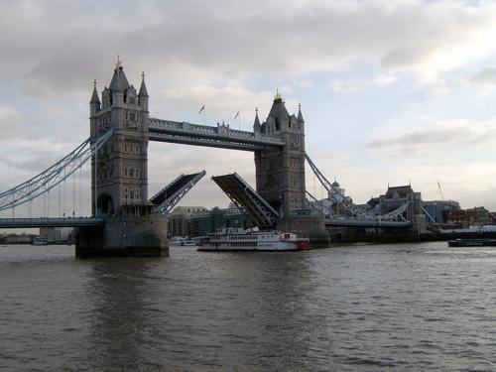
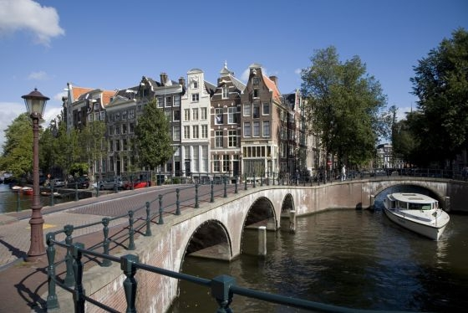
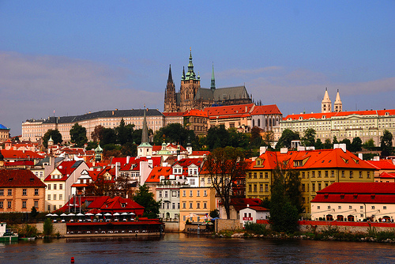
Use Case 1: Horizontal Partitioning
Phosporous circuit (now dismantled)
Geant2 used two names for two sections
NetherLight used one name for whole path
NetherLight: #5030LE
GEANT2: #07017
GEANT2: #07016
London
Amsterdam
Prague

Slide 24
Use Case 2: Vertical Partitioning
JIVE circuit C5
Runs over AARnet, CENIC, CANARIE, SURFnet, and others.
“CENIC service is provided by NLR”
JIVE: #C5
NLR: #AUS-SEA-5
CENIC: #NLR-LOSA-SEAT-O192-258
Narrabi
Sydney
Los Angelos
Seattle
New York
Amsterdam
Dwingeloo

Slide 25
Virtualisation Discussion
NSI discussion, really

Slide 26
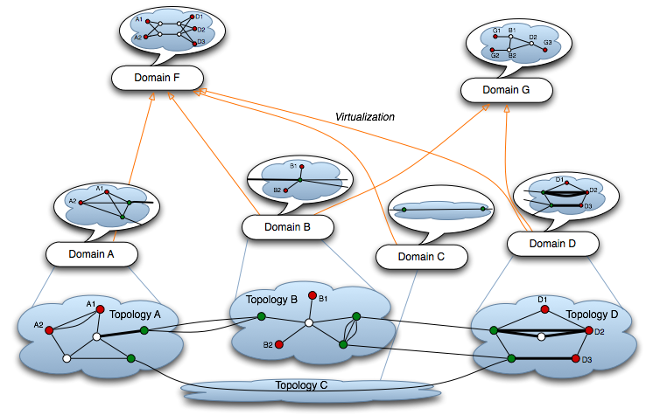
Virtualization

Slide 27
Identifiers
Freek Dijkstra

Slide 28
Identifiers
–

Slide 29
Addenda to Proposals

Slide 30
Yeah or Nay
Start
Current Proposal OK?
Authors willing to revise?
no
no
yes
yes
Integrate in document
Back to the drawing board
New volunteers

Slide 31
Some Questions
Network
Relation topology:domain 1:1, many:1 or 1:many?
Why is domain only for a network, considering the "any IT" mention in infrastructure service BoF?
Is there input from the recent topology discussion in the NSI?
Adaptation
no multiplexing/inverse multiplexing
Layer definition contains “collection of port”

Slide 32
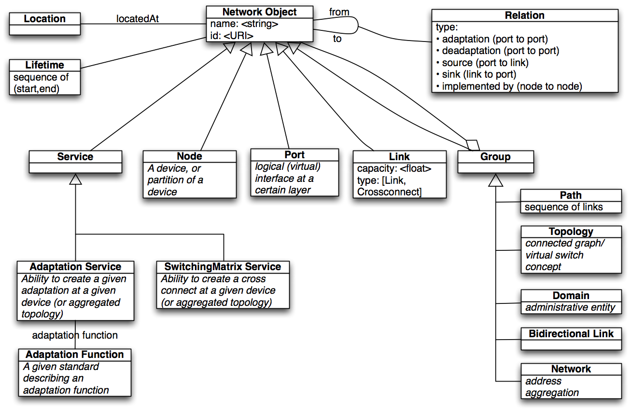
Current Schema

Slide 33
Full Copyright Notice
Copyright (C) Open Grid Forum (2010). All Rights Reserved.
This document and translations of it may be copied and furnished to others, and derivative works that comment on or otherwise explain it or assist in its implementation may be prepared, copied, published and distributed, in whole or in part, without restriction of any kind, provided that the above copyright notice and this paragraph are included on all such copies and derivative works.
The limited permissions granted above are perpetual and will not be revoked by the OGF or its successors or assignees.
Notes:
OGF Full Copyright Notice if necessary

